Slide 1
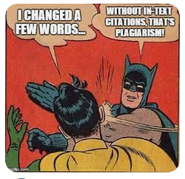
Plagiarism AKA Academic Honesty
(Hulu, n.d.)

Slide 2
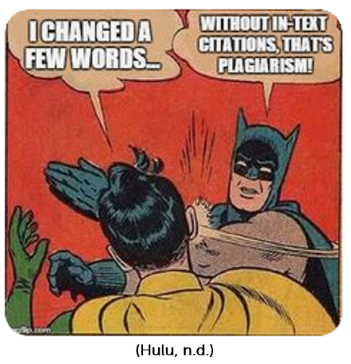
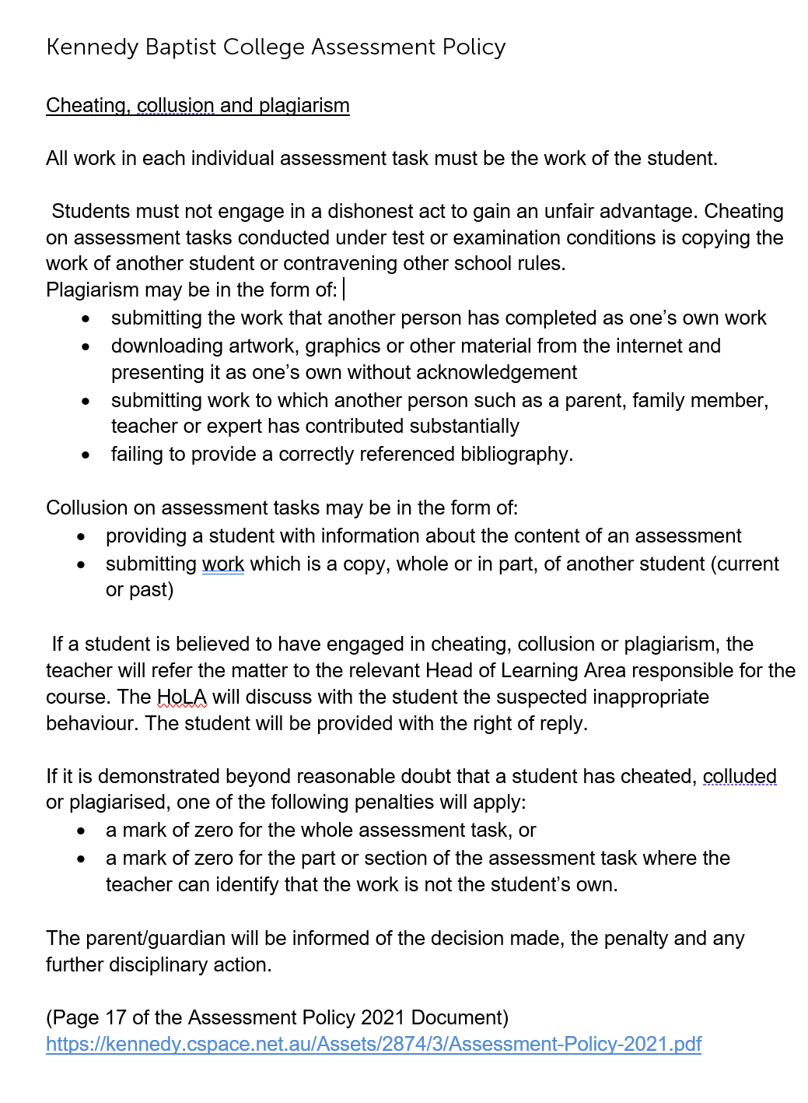

Slide 4
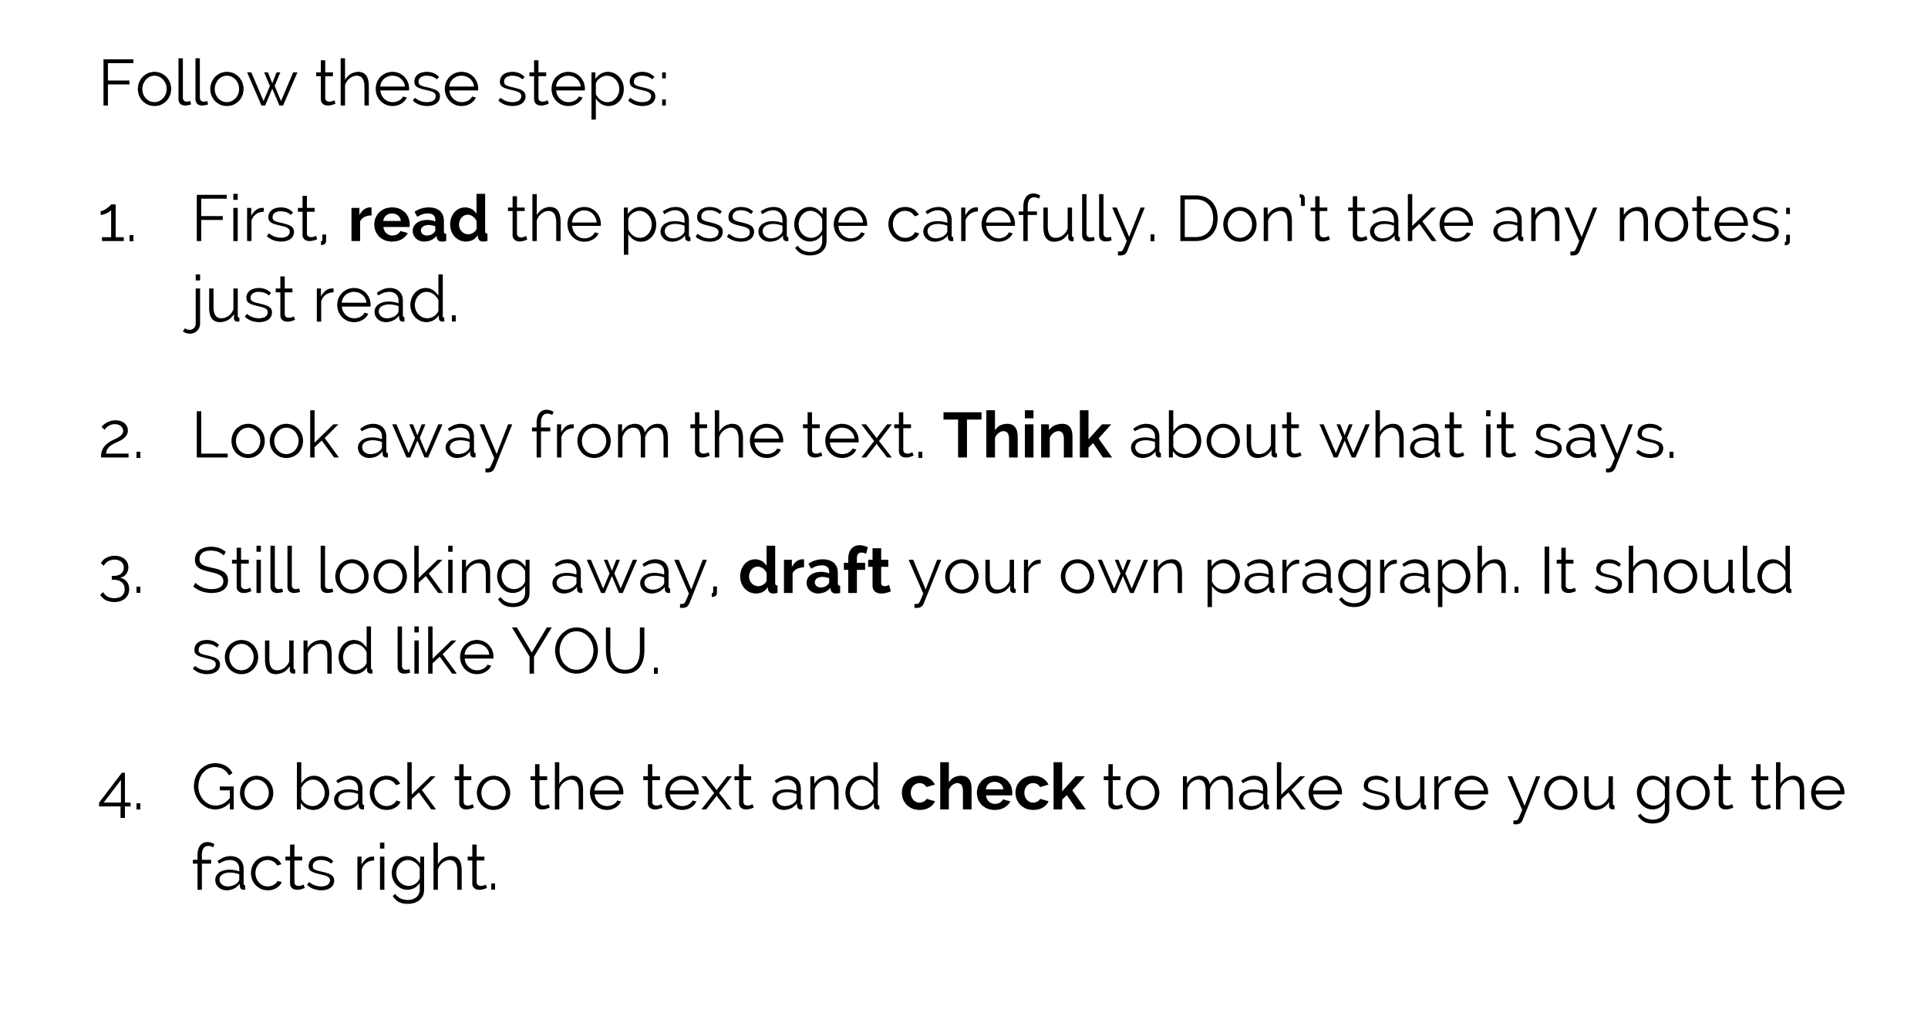
Look, Cover, Write, Check!

Slide 5
1. PARAPHRASING : Restating the ideas presented within a text in your OWN words and giving the author credit. This could involve briefly summarising the main ideas from your source or restating the points of a specific excerpt. Either way, you use your own words and give the author credit.
2. DIRECT QUOTATION: Copying some of the author’s exact words, surrounding them with “quotation marks” and giving the author credit. (Gonzalez, 2017)

Slide 7
Bibliography
Gonzalez, J. (2017, February 26). Teaching students to avoid
plagiarism. Retrieved from Cult of Pedagogy:
https://www.cultofpedagogy.com/preventing-plagiarism/
Hulu, F. (n.d.). Plagiarism. Retrieved from Pinterest:
https://www.pinterest.com.au/hululuuu/plagiarism/

