Slide 1
Year 11 politics & law
Assessment 3| Undemocratic vs Democratic Nations| Research Guide

Slide 2
Check your facts!
Beware of sources used.
Notes:
Insert a map of your country.

Slide 3
STop! Who is behind the information
Examine the source of the website
Wikipedia check
Notes:
Insert a picture of one of the geographic features of your country.

Slide 4
Investigate the source
Open another search tab
Search using keyword and read laterally
Example keywords:
political system
legal system
Australia versus China
democracy
How Do I Determine a Shortlink's Destination? - Ask Leo!
Notes:
Insert a picture of one of the geographic features of your country.

Slide 5
Find a trusted source
Fact checking sites:
Media Bias/Fact Check
FactCheck.org
Snopes.com
FullFact.org
Facebook will pay Reuters to fact-check Deepfakes and more | TechCrunch
Notes:
Insert a picture of one of the geographic features of your country.

Slide 6
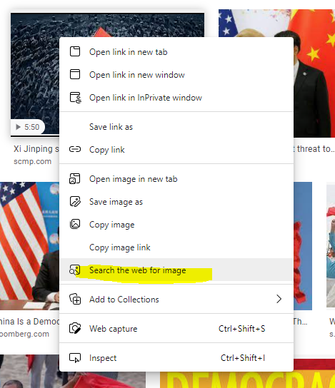
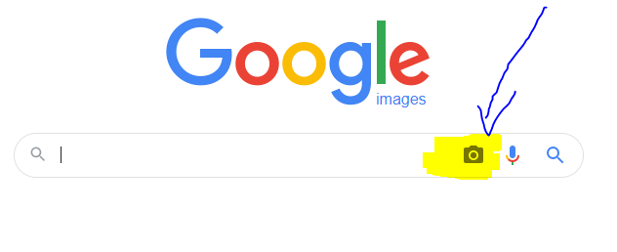
trace the information
Reverse Image Search
https://tineye.com
https://www.reverseimagesearch.com
Google reverse image
Notes:
Insert a picture of one of the geographic features of your country.

Slide 7
Possible resources
Britannica - compare countries
EBSCO
Use Search Engine – refseek.com

Slide 8
Creating the poster
Easiest for design – Canva
Microsoft Publisher
Fotor
Don’t forget to credit images used!
www.canva.com
Notes:
Insert a picture of one of the geographic features of your country.

